Slide 1

ZOOM APP
MAHEK.JALAWADIYA
FYIT_124

Slide 2
WHAT IS A ZOOM MEETING ?
AMERICAN COMPANY
VIDEO CONFERENCING PLATFROM
ZOOM USERS
ZOOM SERVICES
MAHEK.JALAWADIYA
FYIT_124

Slide 3
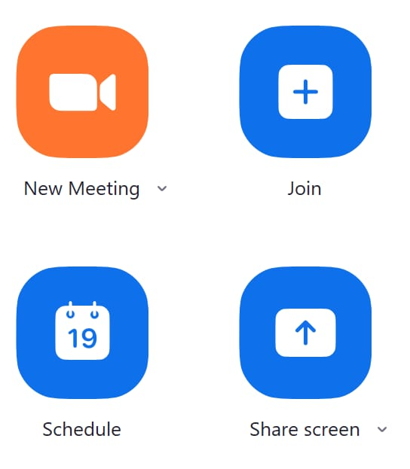
UNDERSTANDING THE ZOOM APP
NEW MEETING
JOIN
SCHEDULE
SHARE SCREEN
MAHEK.JALAWADIYA
FYIT_124

Slide 4
HOW TO JOIN A ZOOM MEETING
SIMPLE TO WAYS
EMAIL SEND TO INVITE YOU
MEETING ID
WHEN YOU HAVE SUCCESSFULLY JOINED MEETING.YOU’LL BE IN IN A “MEETIN ROOM”.
MAHEK.JALAWADIYA
FYIT_124

Slide 5
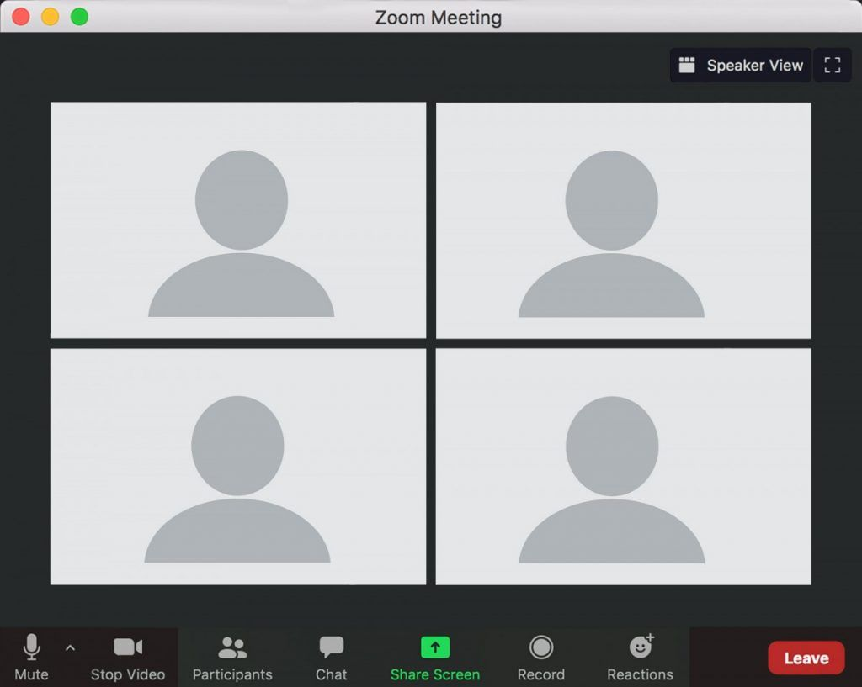
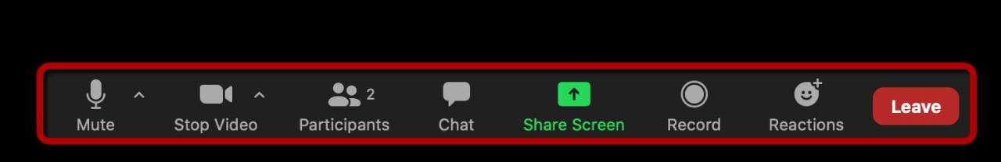
IN MEETING CHAT, CONTROLS AND TOOLS
GALLERY VIEW
SPEAKER VIEW
TOOL BAR
CHAT
HANDS UP
MAHEK.JALAWADIYA
FYIT_124

Slide 6
ADVANTAGES OF ZOOM APP
EASY TO USE
FLEXIBLE TO WORK
VIRTUAL INTERACT
A CENTRALIZED PLATFORM
MAHEK.JALAWADIYA
FYIT_124

Slide 7
FLAWS IN ZOOM APP
VIDEO QUALITY
LIMITED FEATURES
CONNECTIVITY ISSUE
MANY SECURITY ISSUES
MAHEK.JALAWADIYA
FYIT_124

Slide 8


